Slide 1

Progress in next-gen-Kaldi team
Daniel Povey, Kaldi meetup, Nov 13 2022

Slide 2
Summary of progress since last year
Switched focus from CTC + attention decoding to Transducer (as in RNN-T)
More practical for server-based decoding (less memory per stream)
Lots of incremental improvements to WER and training speed
Created a C++ framework “Sherpa” for model deployment
Supports decoding multiple streams in parallel on CPU or GPU
Batch or streaming modes
Overall goal: fast, accurate ASR suitable for product deployment.

Slide 3
Current objectives and focus
Continue to improve model deployment / Sherpa
Improve our capabilities for contextualized / personalized ASR and cross-domain ASR
Continue to improve our models
Our goal is practical ASR that an easily be used for product, i.e.:
Best possible WER
Reasonable training time
Good performance in inference
Easy to contextualize/personalize (e.g. for new words)
We already have good WER and fast training, but need to work on contextualization.

Slide 4
Overview
Will describe our current system (what techniques we are using)
Will briefly go through some of our recent technical work
Will describe our inference framework “Sherpa”

Slide 5
Summary of our current system (batch mode)
Different versions for batch-mode decoding vs. real-time decoding
For batch mode...
Encoder is a modified Conformer or (our current best) Zipformer. Will describe later.
Decoder is a Transducer (like RNN-T).
It is not recurrent because we use “stateless RNN-T”: the decoder only see 2 symbols of history.
We usually decode without LM, since LM doesn’t give very big improvements
Our tools do support decoding and rescoring with various types of LM, e.g. FSAs or neural LMs.
Important for real applications.

Slide 6
Summary of our current system (streaming)
For streaming decoding, we have a few different encoders (the decoder is the same as batch mode):
”Streaming” Conformer with block-wise attention mask, like WeNet
Emformer
Slightly worse WERs than Conformer, and slower to train
Uses less memory in inference time than Cnformer
LSTM
LSTM uses very little memory in inference time
It generalizes much worse on limited training data, but at ~10k hours it is as good as our Conformer.

Slide 7
Some results (non-streaming vs. streaming)
Non-streaming Model | Model size | Test-clean (%) | Test-other (%)
Conformer | 79M | 2.57 | 5.95
Conformer + GigaSpeech | 79M | 2.00 | 4.63
Conformer + GigaSpeech + LM rescoring | 79M | 1.82 | 4.03
​​​
Streaming Model | Model size | Test-clean (%) | Test-other (%)
Conformer, chunk=0.32s | 79M | 3.4 | 9.13
Conformer + GigaSpeech, chunk=0.32s | 79M | 2.81 | 6.82
ConvEmformer, chunk=0.32s, right=0.08s | 75M | 3.43 | 8.86
LSTM | 85M | 3.65 | 9.51
LSTM + GigaSpeech | 85M | 2.73 | 7.15
LSTM + GigaSpeech + LM rescoring | 85M | 2.28 | 5.94
Some trained on LibriSpeech, some on LibriSpeech + GigaSpeech

Slide 8
Decoding with language models
On matched testing data, Transducers perform very well without using a language model (LM-free).
The model ”learns” the language model, but it is mostly learned by the encoder (the decoder only sees 2 symbols of history in our setup).
We do get improvements if we use a language model.
​​​

Slide 9
Decoding with language models
Model | Decoding method | λ1 | λ2 | test-clean | WERR | test-other | WERR
LSTM (Libri+Giga) | Modified beam search | - | - | 2.73 | - | 7.15 | -
 | + SF | 0.3 | - | 2.42 | 11.40% | 6.46 | 9.70%
 | + SF + ILME | 0.3 | 0.05 | 2.36 | 13.60% | 6.23 | 12.90%
 | + SF + LODR (bigram) | 0.3 | 0.16 | 2.28 | 16.5% | 5.94 | 16.9%
Conformer (Libri+Giga) | Modified beam search | - | - | 2 | - | 4.63 | -
 | + SF | 0.3 | - | 1.96 | 2.00% | 4.18 | 9.70%
 | + SF + ILME | 0.3 | 0.05 | 1.82 | 9.0% | 4.1 | 11.40%
 | + SF + LODR (bigram) | 0.4 | 0.14 | 1.83 | 8.50% | 4.03 | 13.0%
SF == shallow fusion
ILME == internal LM estimation (done by zeroing encoder embedding)
LODR == use bigram LM to estimate internal LM to subtract
​​​

Slide 10
Decoding with language models
In the near future we want to focus on applying LM rescoring for mismatched-domain situations.
Important for real applications.
Our tools also support decoding RNN-T with an FSA/FST
Supports lattice generation
Investigating the use of this for contextualized ASR.
​​​

Slide 11
Some recent technical work
Now that I have described what our overall system looks like, I will give some more specific examples of our recent work
A sampling of papers and other work
Pruned Transducer (for faster training)
Delay-penalized Transducer (for streaming decoding with low latency)
Distillation with Multi-Codebook Indexes (improve WER of small models using codebooks from activations of large models)
Zipformer (== reworked Conformer)

Slide 12
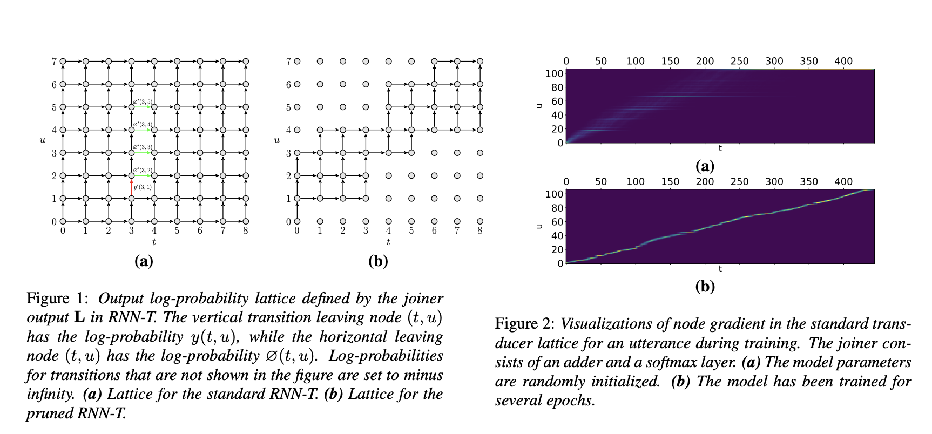
Pruned Transducer training

Slide 13
Pruned Transducer Training
Reduce memory and time requirements for the Transducer loss computation
Can be significant if this dominates memory or time requirements of training
E.g. with large vocabulary size, the normal RNN-T loss computation can use a lot of memory.

Slide 14
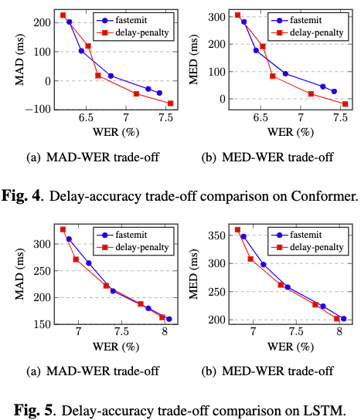
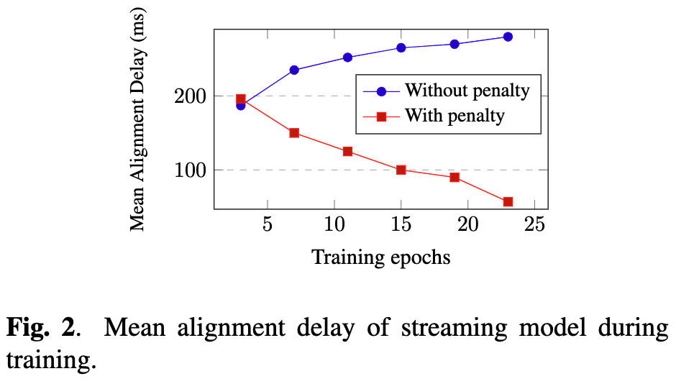
Delay-penalized Transducer

Slide 15
Delay-penalized Transducer
Method is very simple: add a small constant times the frame-index to all non-blank probs at the input to the RNN-T loss.
Delay/WER tradeoff is slightly better than Google’s “FastEmit” method
We have (IMO) a better justification for why our method should work.
I.e. less add-hoc.

Slide 16
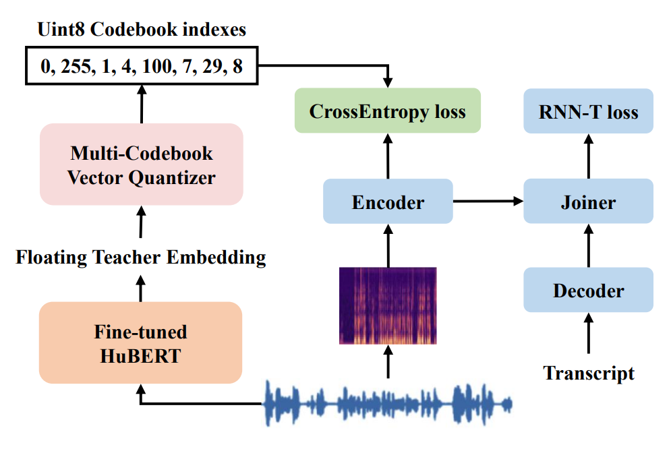
Knowledge Distillation by predicting multi-codebook Quantization Indexes

Slide 17
Knowledge Distillation by predicting multi-codebook Quantization Indexes
For knowledge distillation from large models like Hubert
We use (predicting codebook entries) as auxiliary loss
Similar performance to predicting Hubert embeddings via l1 or l2
But more efficient: no need to either inference the Hubert model on each batch, or load very large embedding vectors from disk.
Space/IO saving of 256 times without clear loss in performance.

Slide 18
Zipformer
Substantially reworked Conformer
Involves many changes to the recipe, including:
Optimizer changes (“ScaledAdam”)
Temporal U-Net (like Squeezeformer, but simpler downsampling and upsampling)
Re-use attention weights twice in each layer
Learnable layer bypass
More sub-modules per layer
Smaller dimensions inside attention heads
Other innovations for stability (“Whiten” module- add a penalty if the covariance matrix is too far from the identity).

Slide 19
Zipformer: WERs (greedy search, no LM)
Model | Epoch | Directory in Icefall (in egs/librispeech/ASR/) | #params | Test-clean (%) | Test-other (%)
Conformer, (large) | 30 | pruned_transducer_stateless5 | 118M | 2.43 | 5.69
Conformer (default) | 30 | pruned_transducer_stateless5 | 88M | 2.47 | 5.71
Zipformer | 30 | pruned_transducer_stateless7 | 70M | 2.17 | 5.23
Have a PR in icefall about this (should be merged by the time I give this talk)
Working on an substantially better version, will make a pull request soon.

Slide 20
Sherpa
Inference framework for ASR
Server-client setup: you run a server that accepts data from client processes
In the normal setup, server is Python-based (but internally, also uses C++ so it can release the GIL). Also supports C++-only server.
Requirements
Uses PyTorch’s C++ library (or NCNN, but for LSTM-Transducer only)
You need to export the model using torchscript
Mostly uses models from Icefall, but we have also tested others, e.g. from WeNet; Wav2vec_2.0.

Slide 21

Sherpa - features
Supports both batch and streaming ASR
GPU or CPU decoding
Multiple decoding streams can be processed in parallel
Transducer or CTC-based acoustic models
Supports all the decoding methods that we use in Icefall:
Greedy search
Fast beam search (for transducer)
Decoding with a graph (e.g. LG graph)
Endpointing
Streaming ASR demo (Chinese)

Slide 22

Thankyou! Q & A
Next-Gen Kaldi
lhotse does data preparation; suitable for many speech processing tasks
(https://github.com/lhotse-speech/lhotse)
k2 contains all core algorithms written in C++ (and CUDA code)
(https://github.com/k2-fsa/k2)
Icefall is the recipes (the example scripts), it requires lhotse and k2 (https://github.com/k2-fsa/icefall)
Sherpa is the runtime for deployment https://github.com/k2-fsa/sherpa
k2 WeChat Official Account

